Slide 1
COUNTRY WISE POPULATION
1980-2020

Slide 2
INTRODUCTION
The purpose of this dashboard is to analyze population trends across countries, compare population between countries, and understand population distribution clearly and interactively.
Analyze population trends across countries.Compare population between different countries.
Understand population distribution globally.Identify countries with highest and lowest populations.
Highlight average population across all countries.
Provide interactive visualizations for easy analysis
Enable filtering by country for detailed insights.

Slide 3
DATA CLEANING AND TRANSFORMATION
Loaded all period files from 1980 to 2020.Merged multiple files into a single consolidated table.
Removed unnecessary columns like Units and Scale.Checked for missing or blank population values.Corrected inconsistent country names if any.
Converted text values to numeric where required.Unpivoted columns to get 'Country' and 'Population Value'.Standardized column names for clarity.
Ensured all population numbers are in the same units.
Prepared the dataset ready for analysis and visualization in Power BI.

Slide 4
DESCRIPTIVE STATISTICAL ANALYSIS
Calculated the total number of countries in the dataset.Determined the total population across all countries.Calculated the average population across countries.Identified the country with the highest population.
Identified the country with the lowest population.Checked the population distribution across countries.
Observed variations in population among different countries.Summarized population statistics in a clear table.
Ensured data is ready for visualization using charts.
Provided insights for creating interactive dashboards in Power BI.

Slide 5




DAX CALCULATIONS AND MEASURES
AVG_POPULATION = AVERAGE('ConsolidatedFile-1980-2020'[Value])
TOTAL COUNTRIES = COUNT('ConsolidatedFile-1980-2020'[Country])
HIGHEST POPULATION = MAX('ConsolidatedFile-1980-2020'[Country])
TOTAL POPULATION = SUM('ConsolidatedFile-1980-2020'[Value])

Slide 6
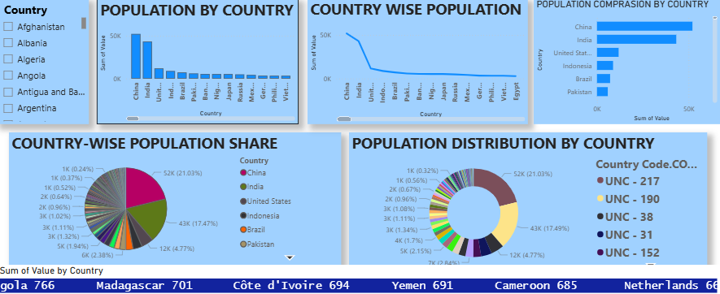
DATA VISUALIZATION
Used Line chart to show population trend across countries.Used Pie chart to show country-wise population share.Used Donut chart for population distribution visualization.Used Bar chart to compare population by country.Used Stacked Bar chart for country-wise comparison.Charts are interactive and update with slicer selection.
Country slicer allows filtering all charts at once.

Slide 7
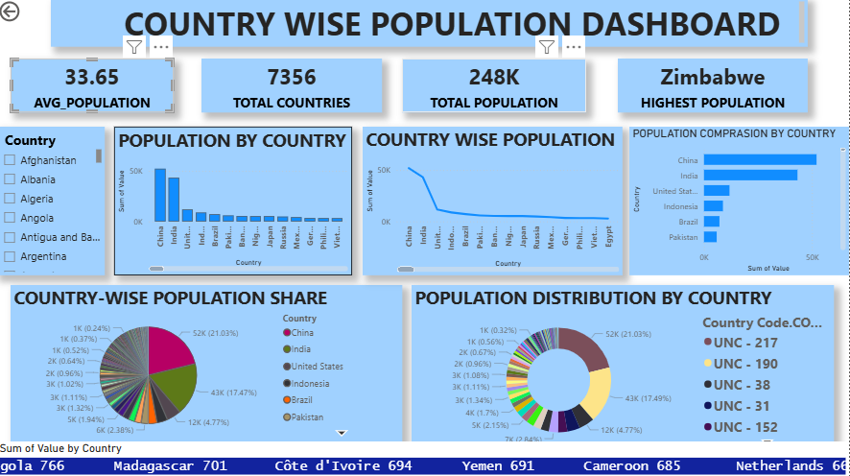
DASHBOARD DESIGN
Dashboard is designed in a clean and simple layout.KP23WQIs and charts are clearly arranged for easy understanding.

